Slide 1
Fluorosis Analysis Presented by:Keerti reddy resapu

Slide 2
CONTENTS
Introduction
Effects of fluorosis
Project aim
Phases
Result
Conclusion

Slide 3
INTRODUCTION
Fluorosis is a health concern associated with the prolonged exposure to high levels of fluoride in drinking water, leading to detrimental effects on dental and skeletal health. Fluoride, a naturally occurring mineral, is often present in water sources, and its concentration can vary geographically. While fluoride is essential for dental health in controlled amounts, excessive exposure can result in fluorosis, a condition characterized by visible changes in tooth enamel and potential skeletal complications.

Slide 4
EFFECTS OF FLUOROSIS
Dental Implications:
Prolonged exposure to elevated fluoride levels can lead to dental fluorosis, a cosmetic concern marked by changes in tooth enamel. Mild fluorosis may result in barely noticeable white streaks on the teeth, while severe cases can cause brown discoloration and enamel pitting. Such alterations not only affect the aesthetic appearance of teeth but also impact oral health.
Skeletal Concerns:
In addition to dental issues, excessive fluoride intake can contribute to skeletal problems. Skeletal fluorosis, a more severe form of the condition, may lead to joint pain, limited mobility, and, in extreme cases, damage to bones and ligaments. Skeletal fluorosis arises from the accumulation of fluoride in bones over an extended period, emphasizing the importance of monitoring fluoride levels in drinking water.

Slide 5
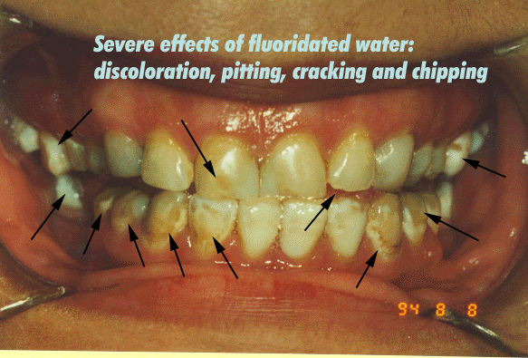

Slide 6
PROJECT AIM
Assessing Fluorosis Risk for Informed Health Decisions:
The primary goal of this project is to evaluate the risk of fluorosis in various regions by analyzing fluoride concentration levels in water sources. Fluorosis, a health concern linked to excessive fluoride exposure, can impact dental and skeletal health. The project aims to provide a comprehensive understanding of the fluoride levels in different areas, empowering individuals with insights into potential health risks.
Key Objectives:
Fluoride Concentration Analysis:
Assess fluoride levels in water sources across regions to identify areas with elevated concentrations.
Demographic Correlation:
Explore the correlation between fluoride content and demographic factors such as age, gender, and geographic location.
Risk Classification:
Classify regions based on the severity of fluorosis risk, ranging from minimal risk to severe risk, considering established thresholds.
Preventive Recommendations:
Provide necessary recommendations for individuals in regions identified with elevated fluorosis risk, emphasizing preventive measures and oral health practices.

Slide 7
PHASES
Data Collection:
Fluoride Concentration Data: Acquired data on fluoride levels in water sources from a dataset, focusing on 2014 data.
I had collected the data from:
2014 Water Fluoridation Statistics | Statistics | Community Water Fluoridation | Oral Health | CDC

Slide 8
Data Storage and Management:
Import into SQL Server: Planned import of acquired data into SQL Server for efficient storage and retrieval.
Data Cleaning: Perform data cleaning procedures to enhance data quality and to remove nulls.

Slide 9
AWS S3 Bucket Creation
Creating an S3 bucket in AWS for several purposes:
Storage of Data: S3 (Simple Storage Service) is a scalable object storage service in AWS.
I use an S3 bucket to store the dataset, specifically the CSV file containing water fluoridation percentages.
Data Accessibility: S3 allows easy and secure access to the data from anywhere on the web.
In my project, i retrieve water fluoridation data from the S3 bucket, making it accessible for analysis.
Scalability and Reliability: S3 is designed to be highly scalable and reliable, ensuring that the data is available
when needed.
This is crucial for a project that involves data analysis and processing.
Security and Permissions: S3 allows you to configure fine-grained access controls and permissions.
This ensures that only authorized users or systems can access and manipulate your data, enhancing security.
Data Versioning and Backup: S3 supports versioning, allowing you to preserve, retrieve, and restore every version
of every object stored in a bucket.
This can be crucial for data versioning and backup, especially if your dataset evolves over time.
Easy Integration with Python and Boto3:
The Python boto3 library, used in my project, provides a convenient way to interact with AWS services, including
S3. I use S3 to store and retrieve the water fluoridation dataset seamlessly within Python code.

Slide 10
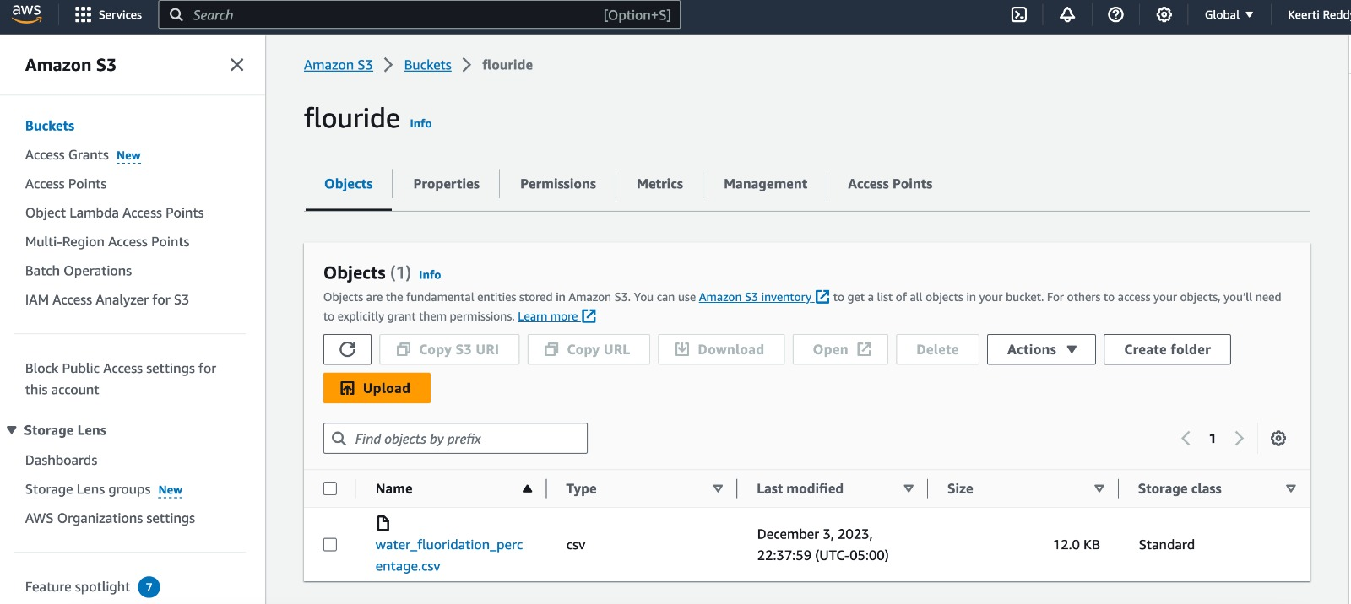

Slide 11
AWS S3 DATA RETRIEVAL
AWS S3 Client Creation:
An AWS S3 client is created using the provided AWS credentials (access key and secret key).
Object Retrieval from S3:
The code attempts to retrieve the specified CSV file (s3_key) from the S3 bucket (s3_bucket).
If successful, the CSV data is read into a Pandas DataFrame (df).
Display DataFrame Columns:
The columns of the DataFrame are printed to provide a quick overview of the retrieved data structure.
Exception Handling:
The code includes exception handling to manage potential errors during the S3 data retrieval process.

Slide 12
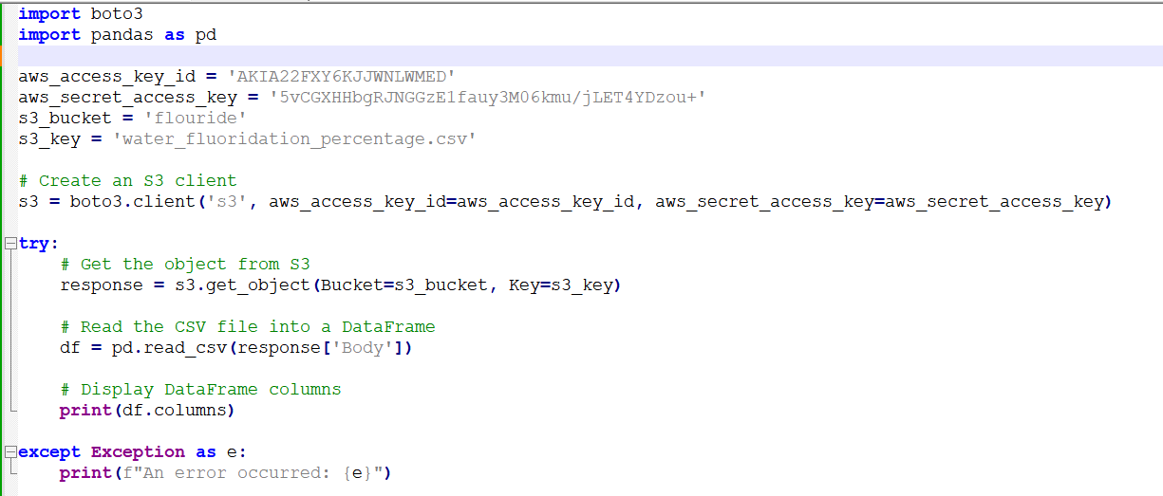
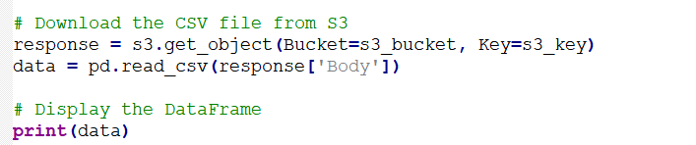

Slide 13
Importing Necessary Libraries:
I started by importing the pandas library, a powerful tool for data manipulation and analysis in Python.
Reading Data from CSV File:
The pd.read_csv function is used to read the dataset into a Pandas DataFrame. This DataFrame (df) contains information about water fluoridation, including postal codes and fluoride content.
User Input:
I prompt the user to enter their postal code, age, gender using the input function.
Data Filtering:
The DataFrame is filtered based on the user-provided postal code. The line postal_code = df[df['postal Code'] == int(postal_code)] selects the row(s) that match the entered postal code.
Displaying Fluoride Content:
To check if the filtered DataFrame (postal_code) is not empty, indicating that data is available for the entered postal code.
If data is available, extract the fluoride content for the specified postal code using postal_code['fluoride Content'].values[0].
The fluoride content is then printed to the console.
Handling No Data Scenario:
If the filtered DataFrame is empty, inform the user that there is no data available for the entered postal code.

Slide 14
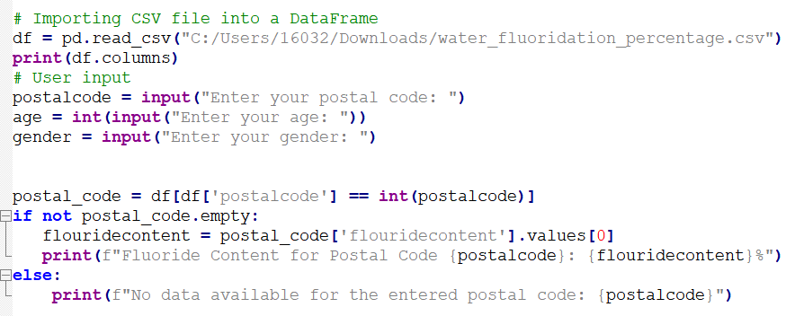

Slide 15
Age and gender effects
Age_affected Function:
This function takes the user's age as input and returns a prevalence percentage based on different age groups.
If the age is 20 or below, it returns 43%.
If the age is between 20 to 50, it returns 32%.
If the age is between 50 to 70, it returns 20%.
For ages above 70, it returns 5%.
Gender_affected Function:
This function takes the user's gender as input and returns a prevalence percentage based on the gender.
If the gender is 'male' it returns 54%.
For any other gender, it returns 46%.

Slide 16
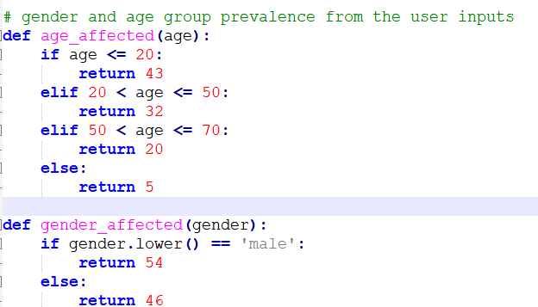

Slide 17
Fluorosis Risk Assessment
if flouridecontent <= 30:
If the fluoride content is less than or equal to 30, the condition is true.
The code inside this block will execute, and it prints "This region is not affected by fluorosis."
This suggests that the fluoride concentration in the region is considered safe.
elif 30 < flouridecontent <= 65:
If the first condition is false (fluoride content is not less than or equal to 30), it checks this condition.
If the fluoride content is greater than 30 but less than or equal to 65, the condition is true.
The code inside this block will execute, and it prints "This region is affected by fluorosis."
This suggests that the fluoride concentration is in a moderate range, indicating a potential risk of fluorosis.
else:
If both previous conditions are false (fluoride content is neither less than or equal to 30 nor in the range 30 to 65), this block executes.
It prints "This region is affected by severe fluorosis."
This indicates that the fluoride concentration is high, posing a severe risk of fluorosis.

Slide 18
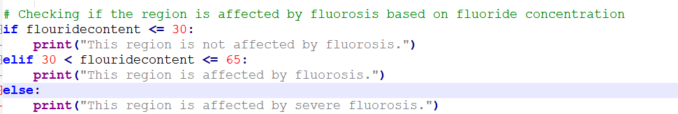

Slide 19
Combined Percentage Calculation
The variable pc is assigned the value of flouridecontent. This step stores the fluoride content of the region in the variable pc for later use in the calculation.
age_category_result = age_affected(age):
This function calculates the percentage effect of age on fluorosis risk based on predefined criteria.The result is stored in the variable age_category_result.
gender_category_result = gender_affected(gender):
This function calculates the percentage effect of gender on fluorosis risk based on predefined criteria.The result is stored in the variable gender_category_result'
combine_total = age_category_result + gender_category_result + pc:
The variables age_category_result, gender_category_result, and pc are added together, and the result is stored in combine_total. This represents the sum of the age effect, gender effect, and fluoride content.
combined_percentage = (combine_total / 300) * 100:
The combined total (combine_total) is divided by 300, representing the maximum possible combined value (100 for fluoride content, 100 for age, and 100 for gender).
The result is multiplied by 100 to convert it to a percentage.
The final combined percentage is stored in the variable combined_percentage.

Slide 20
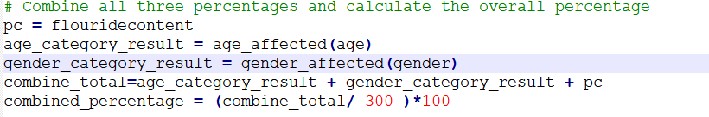

Slide 21
Providing Preventive Recommendations
if combined_percentage <= 20:
If the combined percentage is less than or equal to 20, it suggests a mild risk of fluorosis.
Recommendation: Maintain regular dental hygiene to prevent dental fluorosis.
elif 20 < combined_percentage <= 50:
If the combined percentage is between 20 and 50, it suggests a moderate risk of fluorosis.
Recommendation: Use fluoride-free toothpaste and consider water filtration.
elif 50 < combined_percentage <= 75:
If the combined percentage is between 50 and 75, it suggests a high risk of fluorosis.
Recommendation: Use fluoride-free toothpaste, consider water filtration, and consult a dentist to prevent teeth loss.
else:
If none of the above conditions are met (combined percentage greater than 75), it suggests a severe risk of fluorosis.
Recommendation: Seek immediate professional dental advice.

Slide 22
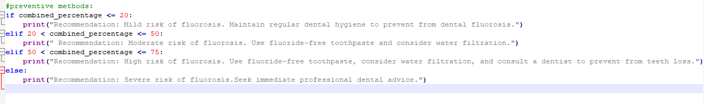

Slide 23
PROJECT RESULT
Fluoride Content Assessment:
The project extracts and displays the fluoride content for the user-input postal code.
Risk Assessment:
Determines the region's fluorosis risk based on the fluoride concentration.
"Not affected" if <= 30 %.
"Affected" if 30% < fluoridecontent <= 65%
"Severe fluorosis" if > 65%
Combined Percentage Calculation:
Combines age, gender, and fluoride content percentages.
Calculates the overall combined percentage out of 100.
Recommendations:
Provides tailored recommendations based on the combined percentage.
"Mild risk" suggests maintaining regular dental hygiene.
"Moderate risk" recommends fluoride-free toothpaste and water filtration.
"High risk" advises consulting a dentist for preventive measures.
"Severe risk" urges immediate professional dental advice.
In summary, the project offers a user-friendly interface to assess fluorosis risk, providing informative recommendations for preventive measures based on individualized factors.

Slide 24
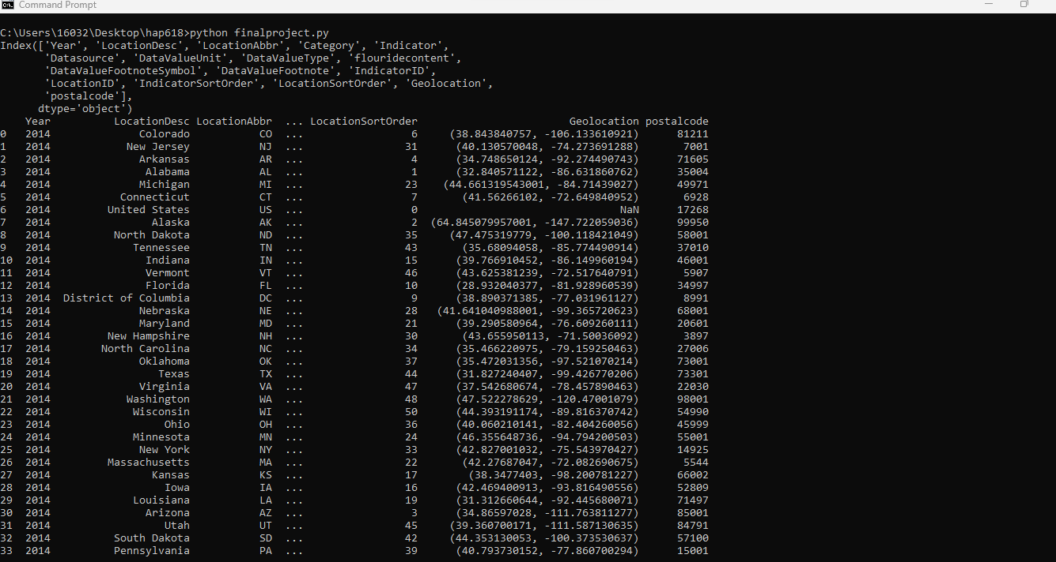

Slide 25
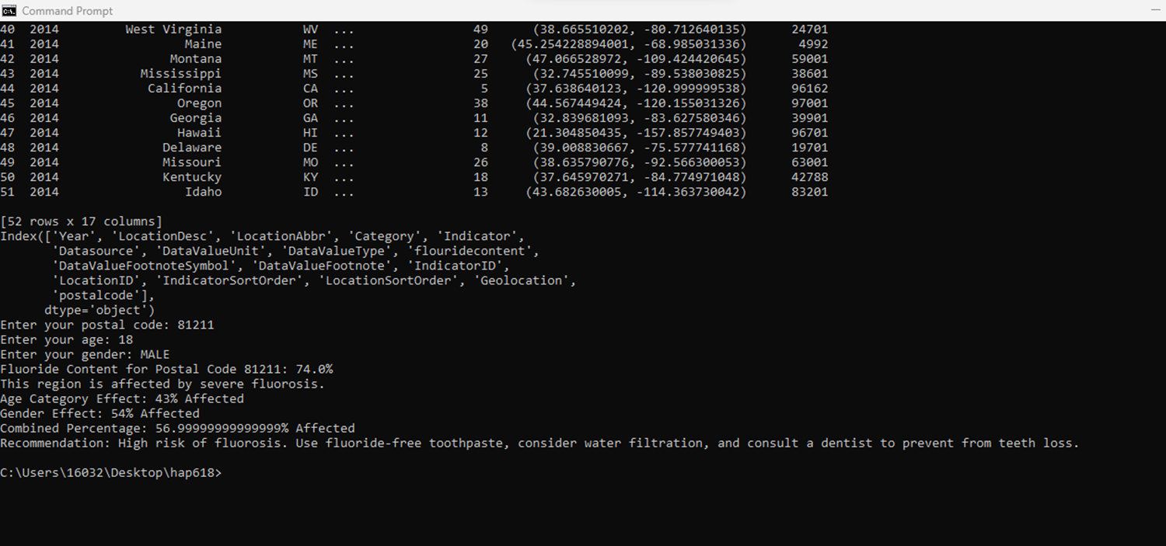

Slide 26


Slide 27
Conclusion
To sum up, the Fluorosis analysis project initiative is a big step in an appropriate way towards using technology to provide individualized oral health insights. The combination of data analysis, user-friendly interfaces, and AWS S3 connection shows how these technologies might improve public health awareness and preventive care.
Key Achievements:
Personalized Risk Assessment: The project successfully delivers personalized assessments, taking into account age, gender, and regional fluoride concentration.
AWS Integration: Leveraging AWS S3 for data storage and retrieval ensures robustness, scalability, and security, making the system suitable for real-world applications.
User-Friendly Interface: The inclusion of a user-friendly interface simplifies the process for individuals to access relevant information about the fluorosis risk in their region.
Informative Recommendations: Going beyond assessment, the project provides actionable recommendations based on the severity of the risk, promoting preventive dental health practices.
Educational Component: The project incorporates an educational aspect, informing users about the severe effects of fluorosis and empowering them to take proactive measures.
In essence, the Fluorosis Risk Assessment project is not just a technological solution; it's a commitment to community health, preventive care, and a future where technology converges with well-being.

Slide 28
References
Python Tutorial (w3schools.com)
2014 Water Fluoridation Statistics | Statistics | Community Water Fluoridation | Oral Health | CDC
Step by Step Guide for AWS S3 Bucket Creation. | by Shubham Dubey | Towards AWS
How to read CSV file from Amazon S3 in Python - DEV Community

Slide 29
Thank You

